Slide 1
// Projects

Slide 2
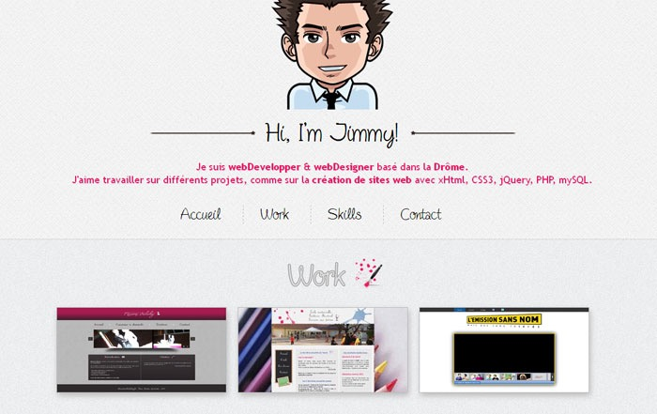
Your Portfolio Page
Tell your story
Create an info page about you
Show people what you create later in this class
List your skills to show employers

Slide 3
Examples
You can create a one page application like this:
http://haraldurthorleifsson.com/
Or multiple paged portfolio like:
http://www.adhamdannaway.com/
or http://keithclark.co.uk/

Slide 4
Requirements
Name
A Picture
A few sentences about you
A list of your skills
A few of your favorite links

Slide 5
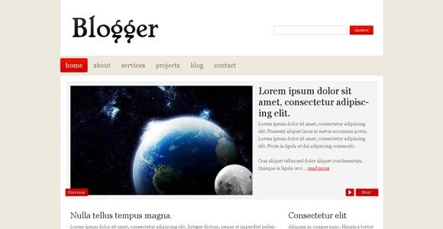
Build a Blog
Create a place where you can write your thoughts and experiences
Write about this class
Add photos and descriptions about a holiday or weekend

Slide 6
Requirements
User can…
Add a story
Delete a story
Edit a story
View a story

Slide 7
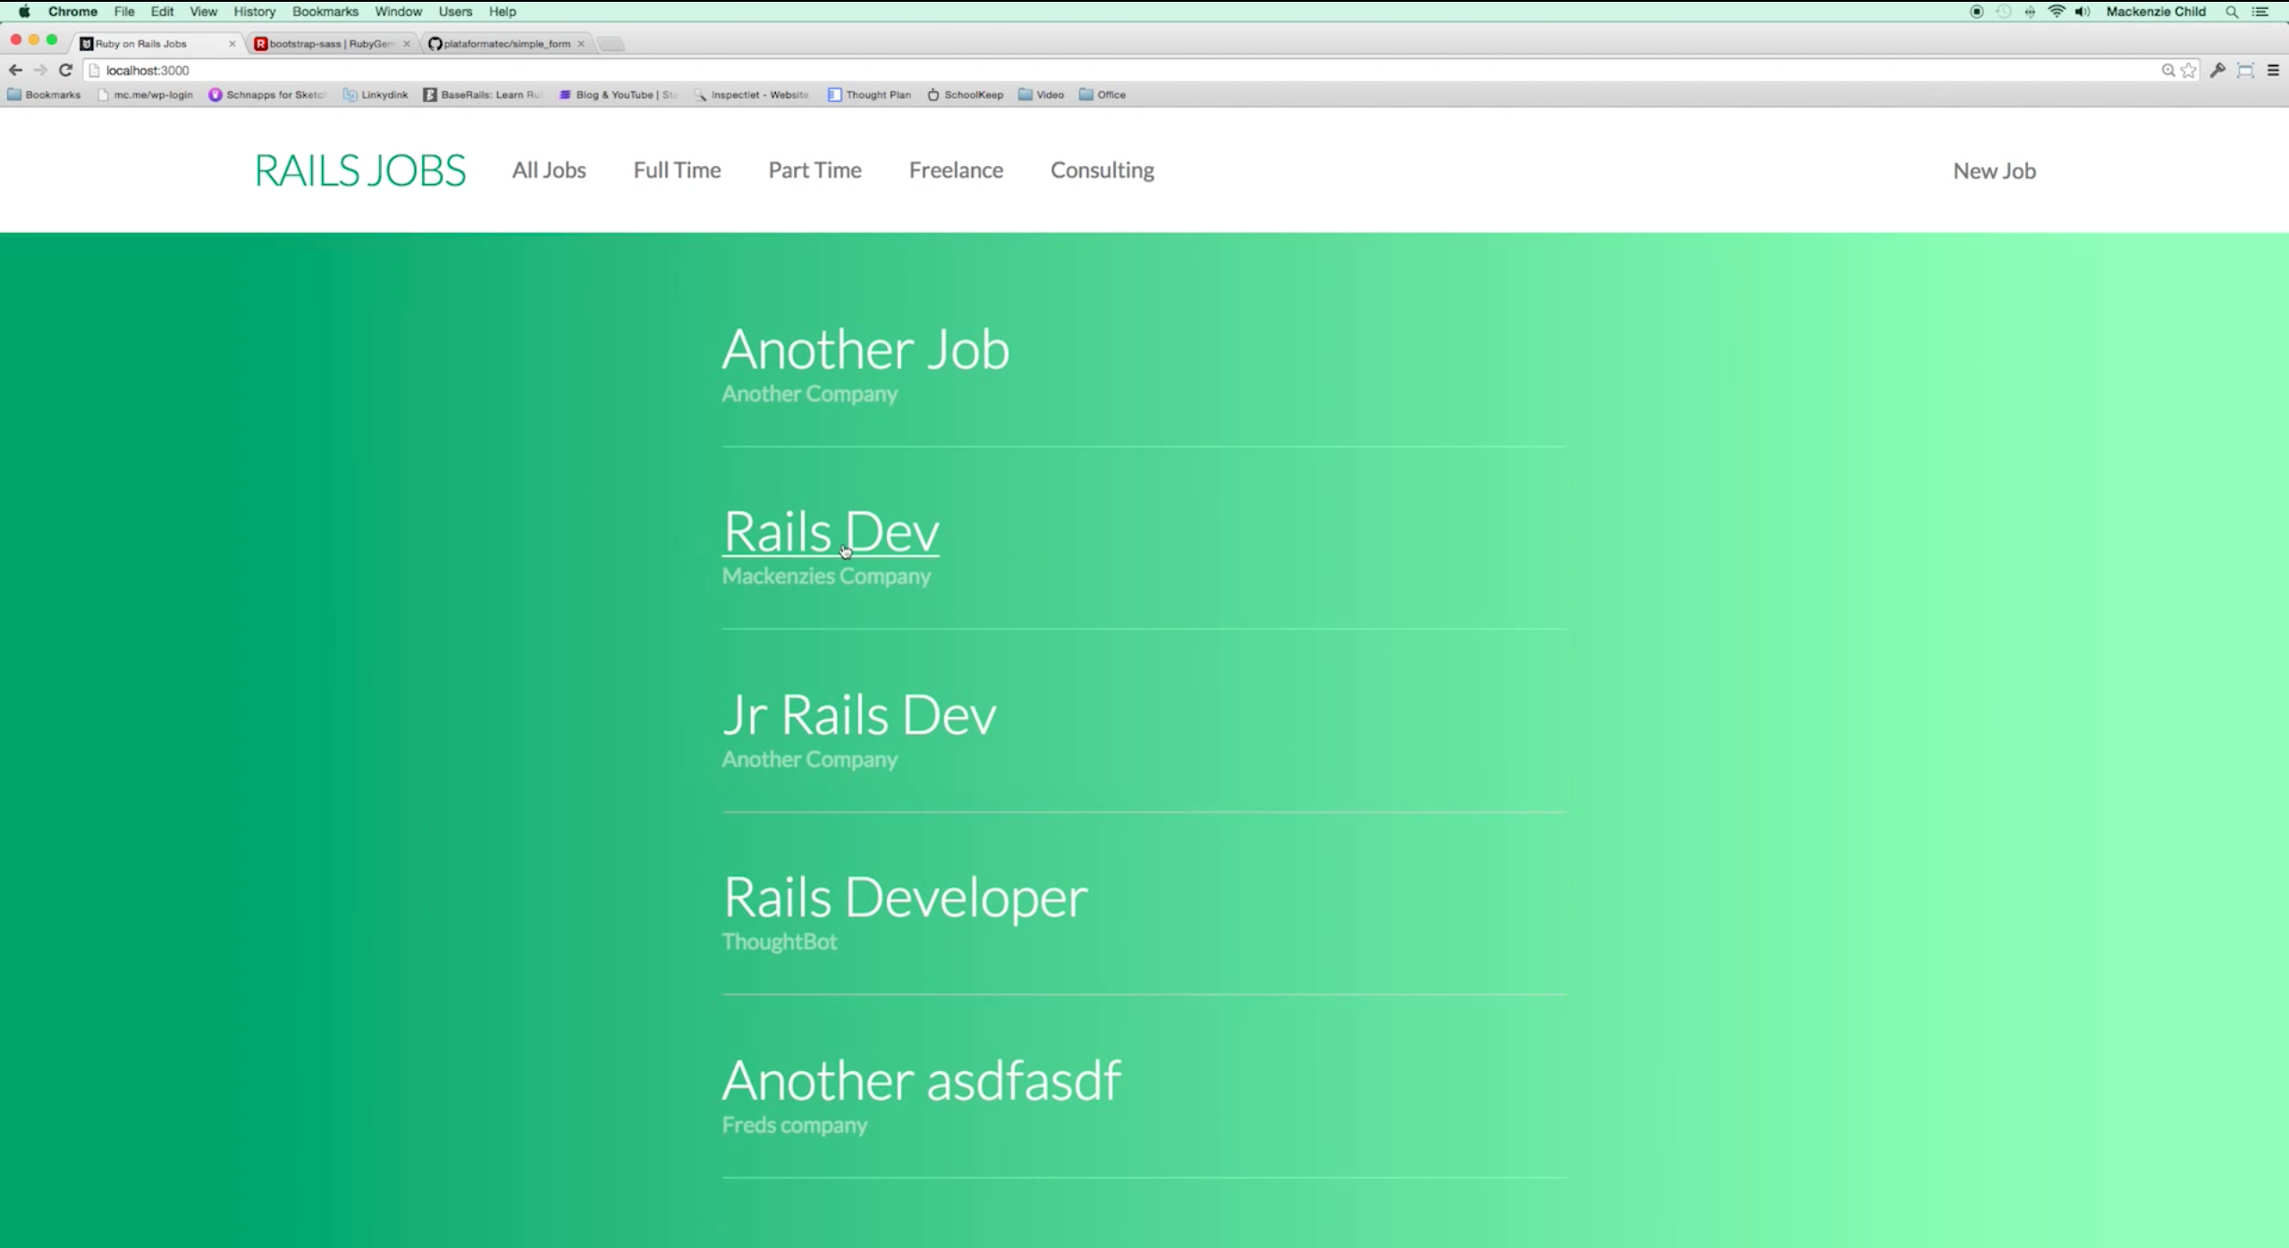
Create a Job Board
List dynamic information
Add content
Create newfeeds, stories, skill lists

Slide 8
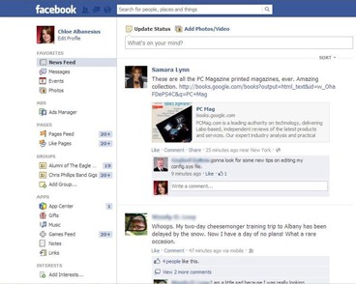
Examples
Can also create a news feed with this like Facebook
or…
news list
list of shopping items for an online store
articles for an online newspaper

Slide 9
Requirements
Posts (Jobs or other content)
Multiple pages and routes
User can click on content for more information
User can filter content

Slide 10
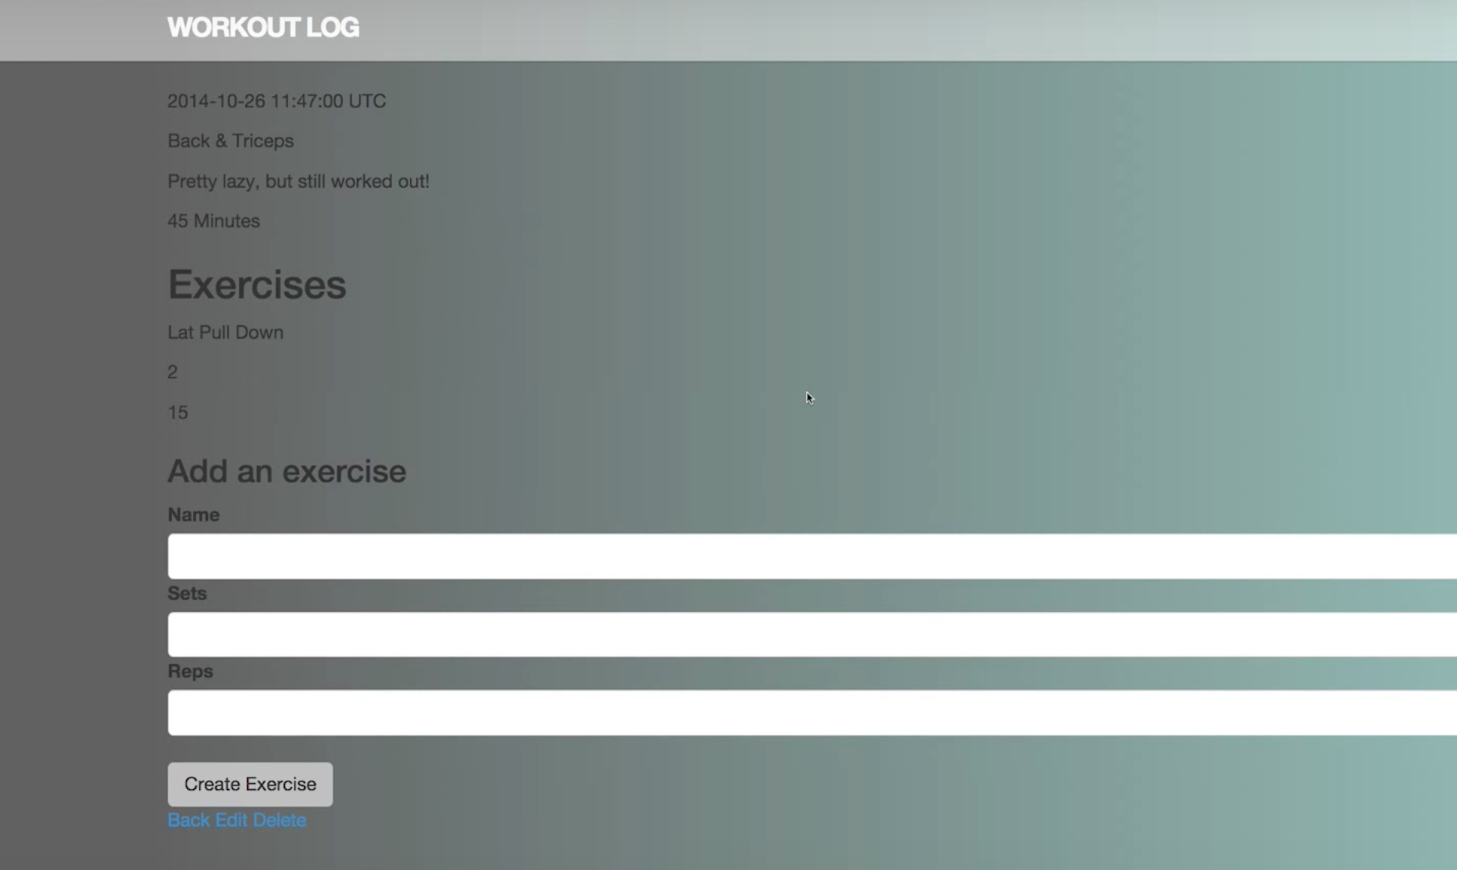
Final Project
Idea be anything!
Can build a website to solve a problem you have!
Here is an example of a workout tracker

Slide 11
Examples
http://www.start-with-a-friend.de/
http://www.kub-berlin.org/index.php/en
http://www.daz.de/sixcms/detail.php?object_id=&area_id=34&id=16358829&template_id=46&lang=de

Slide 12
Requirements
Dynamic content
Uses routes to multiple pages
Use of at least one API

